Slide 1
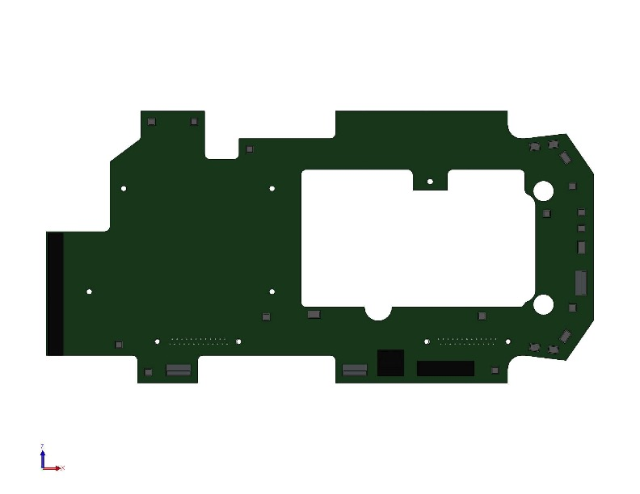
Cooling fan 12VDC
Left LED 12VDC
TX2 power 16VDC
Up-left infrared
Switch power 12VDC
Low-left infrared
Left ultrasound
Left speaker
microphone
Left switch
right speaker
50 pin connector, to STM32 PCB, including I2C, ultrasound & infrared pins, fan enable, LED control, 5VDC, CAN, etc
Payload1 DB25 male, bottom layer
Center ultrasound
----------------- OpenCR power 12VDC
Audio USB
CAN to TX2
Raspberry Pi 5VDC
Right speaker
Right ultrasound
Up-right infrared
Rear LED 12VDC
Payload2 DB25 male, bottom layer
Low-right infrared
Cooling fan, 12VDC
USB power for display
20 pin connector to top PCB. Including JTAG, I2C, CAN, 16VDC, 5VDC
Right LED 12VDC
Payload 1 USB2.0
Payload 1 eth0, 100M
Front LED power 12VDC

Slide 2
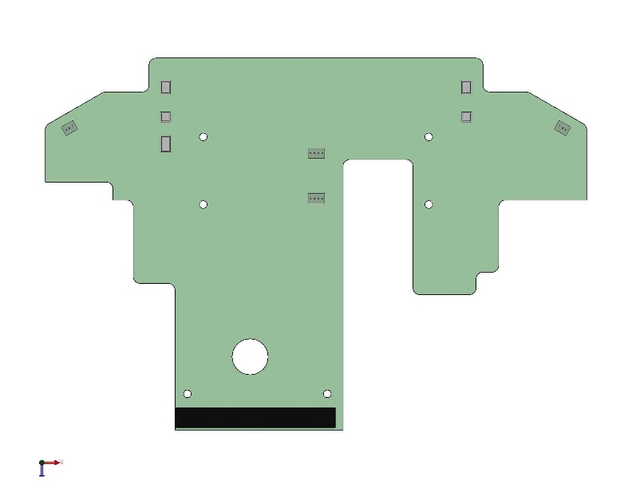
Back right infrared
Back left infrared
Low right infrared (bottom layer)
Low left infrared (bottom layer)
Back right switch
Back left switch
Backward ultrasound (bottom layer)
GPS
Down ultrasound (bottom layer)
50 pin connector, to STM32 PCB, including I2C, ultrasound & infrared pins, fan enable, LED control, 5VDC, CAN, etc

Slide 3
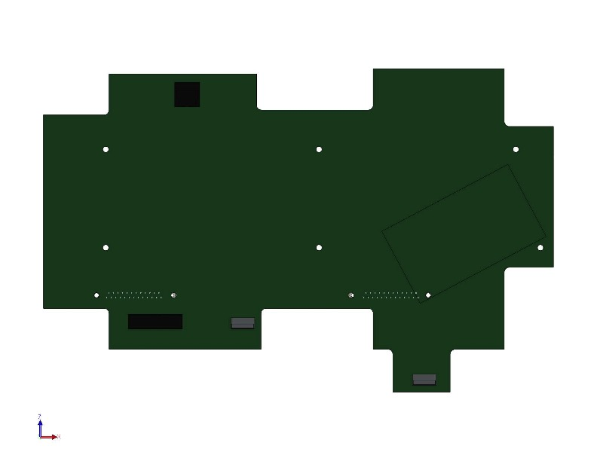
Payload 2 ethernet, 1000M
Payload1 DB25 female, bottom layer
20 pin connector to bottom PCB. Including JTAG, I2C, CAN, 16VDC, 5VDC
Payload 1 USB2.0
Payload2 DB25 female, bottom layer
Payload2 USB3.0

